Slide 1
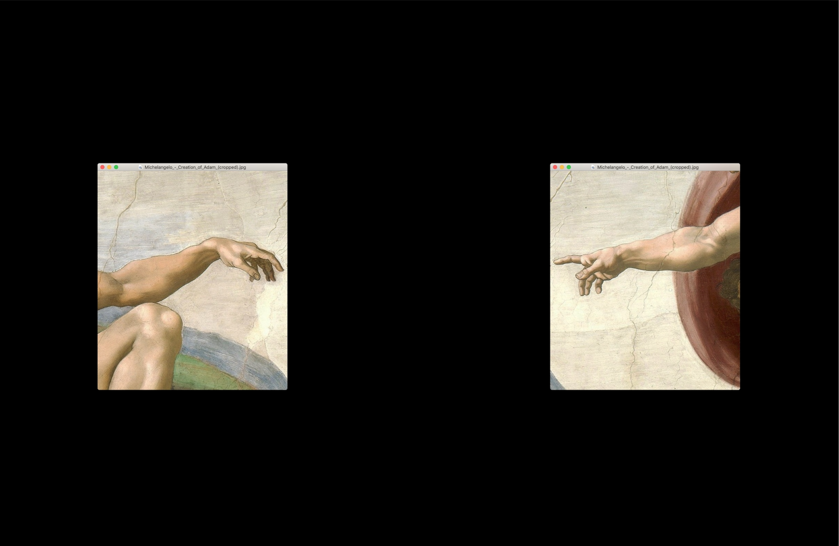
we are adium
Boris Nimcevic
Karolin Valaszkai
Muhammad Irtiza Siddiquie
Prasanna Balaji
Sebin S Philip

Slide 2


Adium Commercial

Slide 4
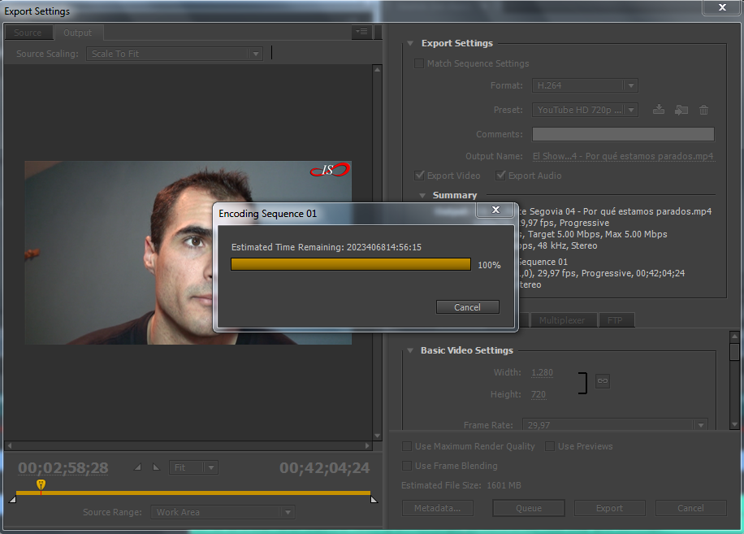

Slide 5
“ .. I have to use Lightroom on the road since my laptop is too slow for Photoshop. But my desktop has failed me as well when I've been working on large high detailed panoramas with many layers. “
- Okra Livia

Slide 6
“ .. I have to use Lightroom on the road since my laptop is too slow for Photoshop. But my desktop has failed me as well when I've been working on large high detailed panoramas with many layers. “
- Okra Livia
“ .. it is always frustrating slow workflow due to the limits of the work environment. “ - Alex

Slide 7
“ .. I have to use Lightroom on the road since my laptop is too slow for Photoshop. But my desktop has failed me as well, when I've been working on large high detailed panoramas with many layers. “
- Okra Livia
“ .. it is always frustrating ‘slow workflow’ due to the limits of the work environment. “ - Alex
“ .. problem is that some programs are very resource-demanding in terms of CPU and memory. For example, video editing in Adobe After Effects is a pretty poor experience since everything runs fairly slow. I can also notice that photo editing in Adobe Lightroom makes my laptop become very hot. It's definitely doable, but not ideal -- if I'm doing this "on the go", these programs drain my laptop battery very fast. “
Willy

Slide 8
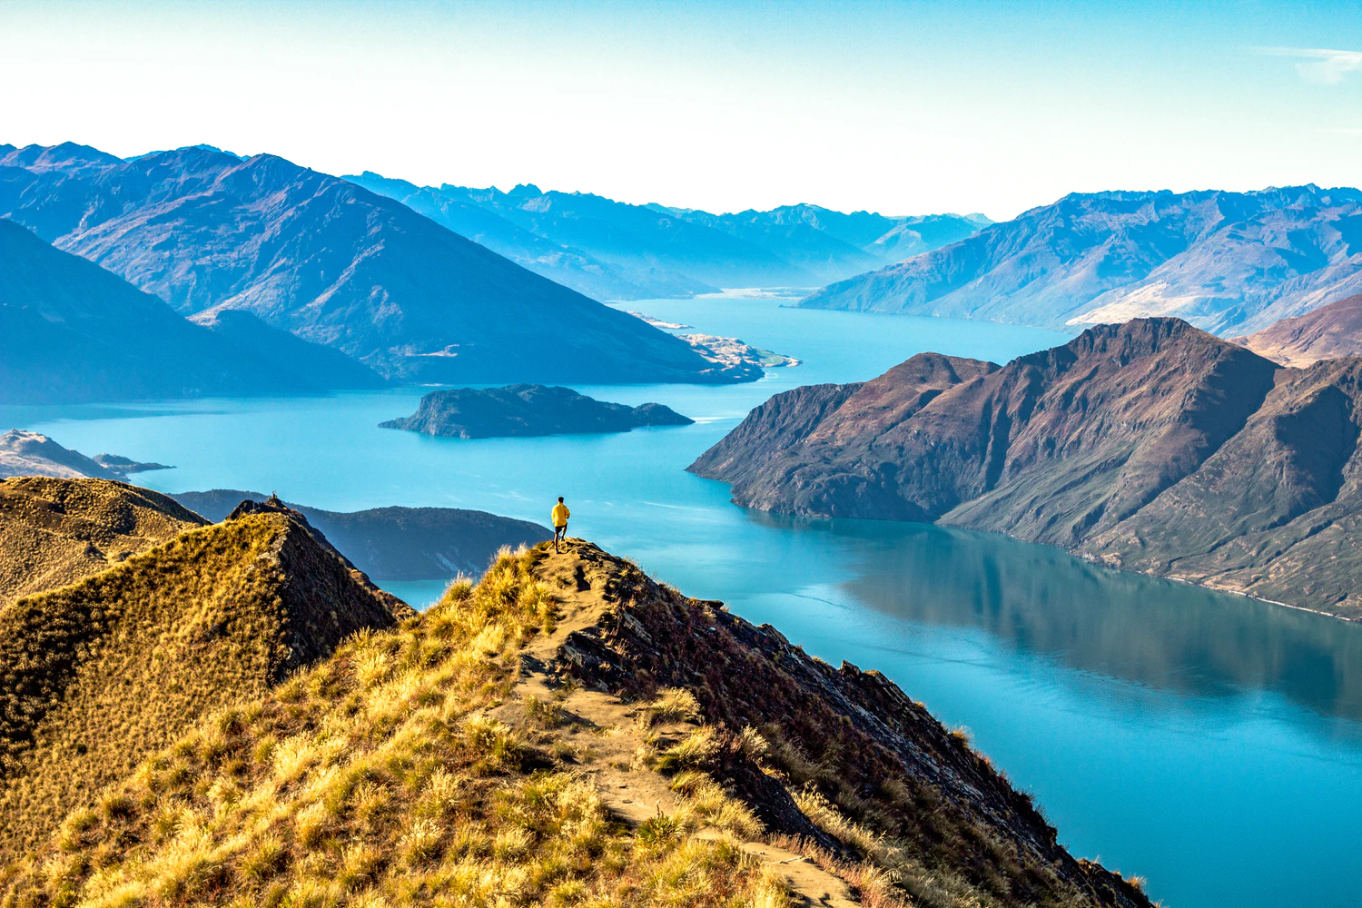
storyboard

Slide 9
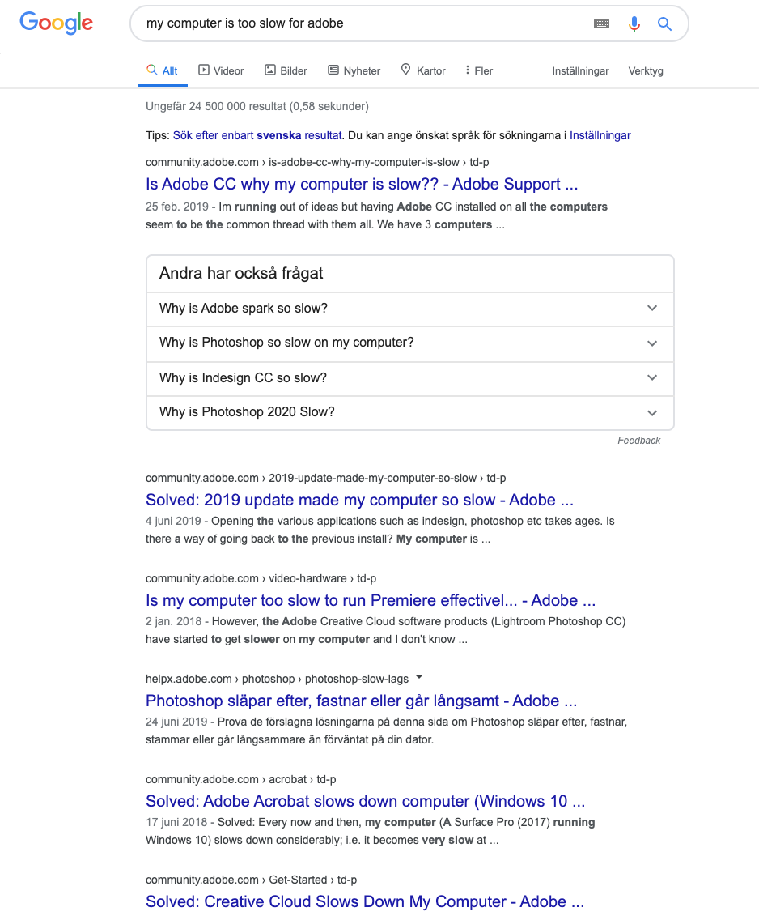
problem

Slide 10
adium
a sustainable quick fix

Slide 11
adium
a sustainable quick fix
to keep your computer
powerful, safe & sustainable
- no matter the hardware

Slide 12
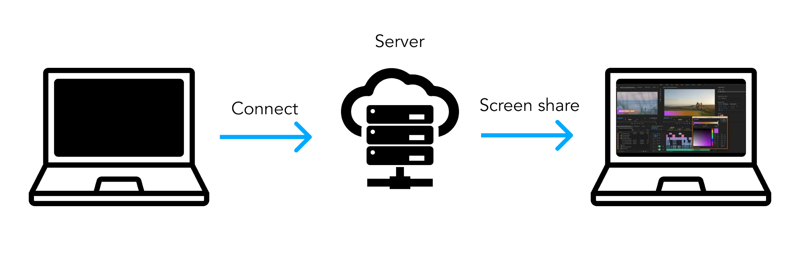
powerful & safe

Slide 13
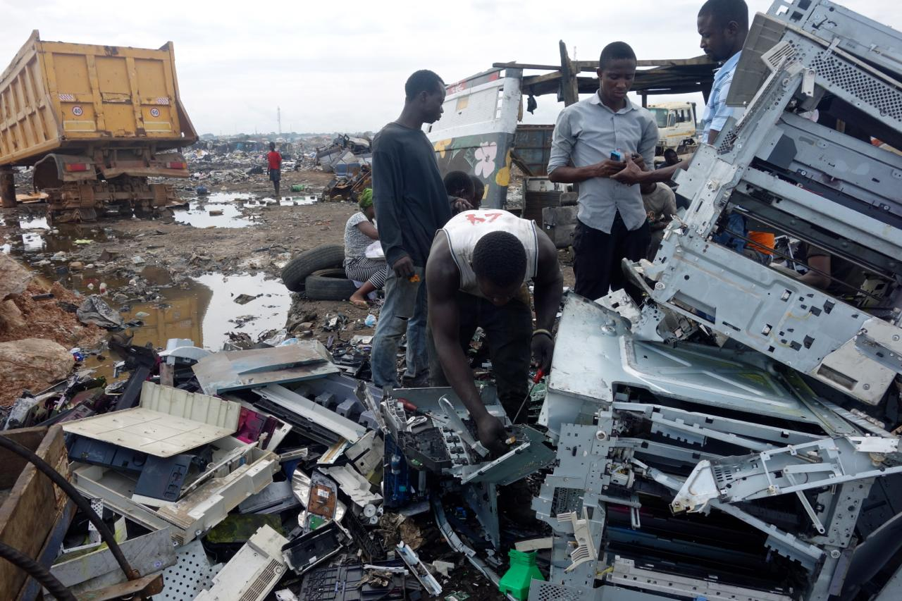
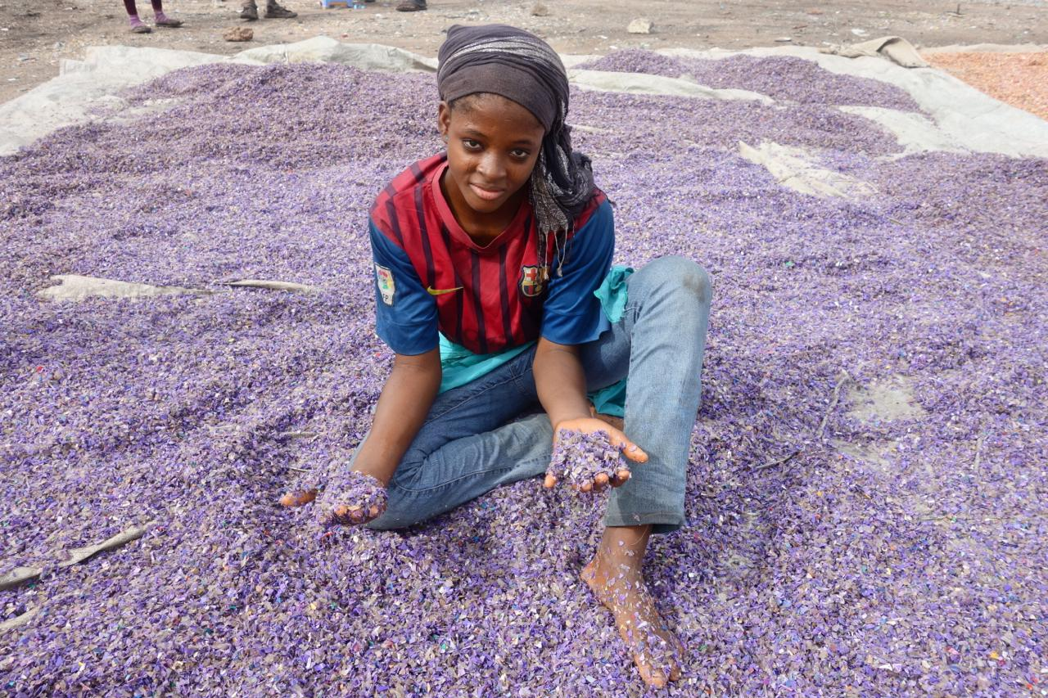
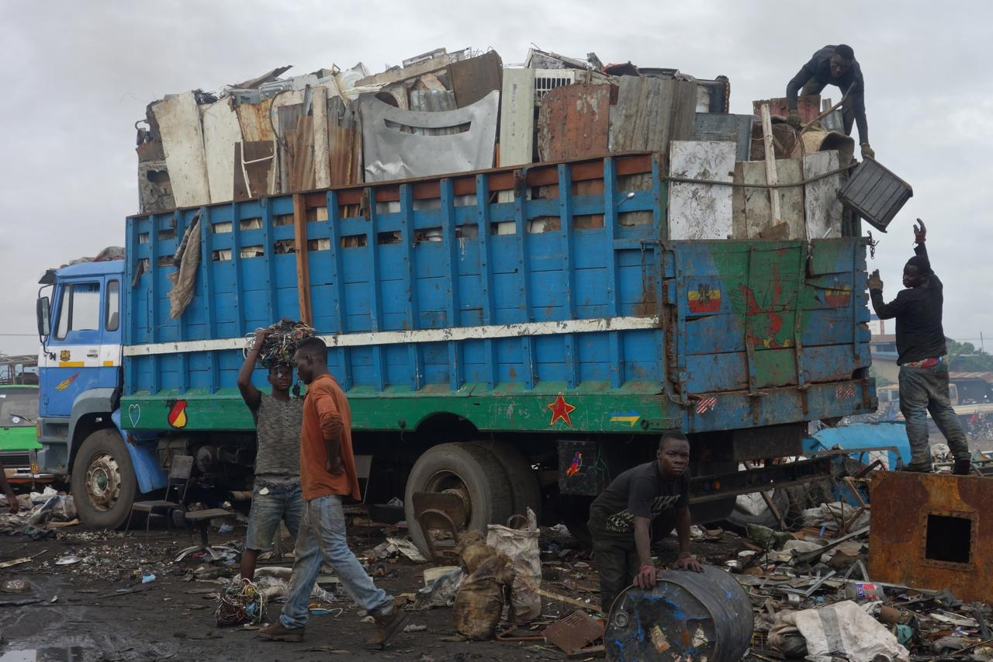
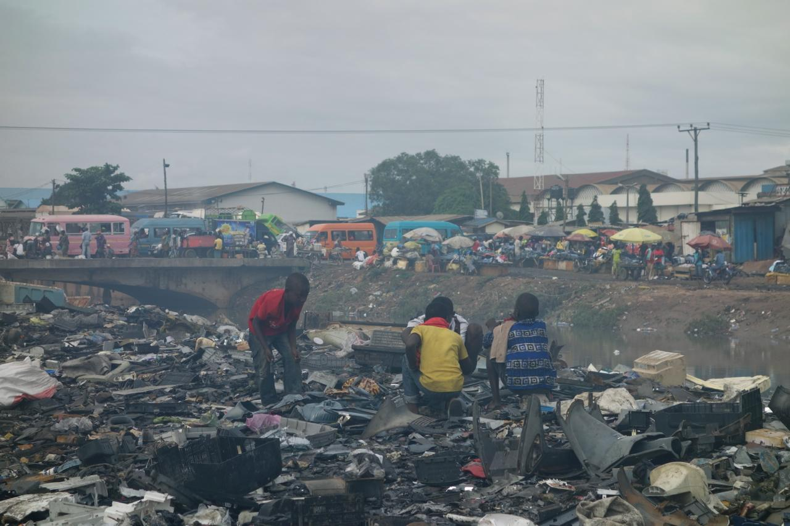
sustainable
50 million tonnes e-waste/year

Slide 14

storyboard

Slide 15
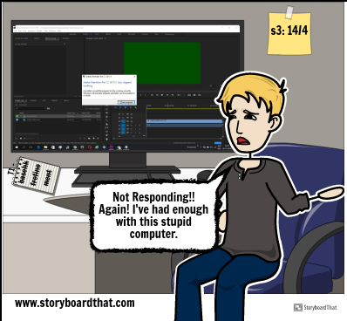
Video Content creator
Inadequate system for intended usage

Slide 16
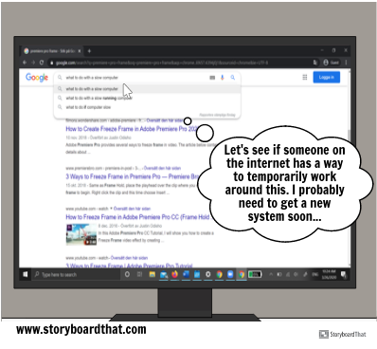
Online search for possible fixes/ ways to speed up computer.
Lands up at our website and is Interested. Tries it out.

Slide 17
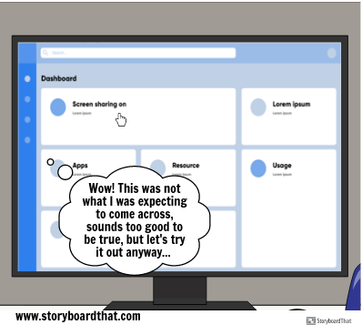
Landing screen of application.
Easy one click toggle access to virtual system

Slide 18
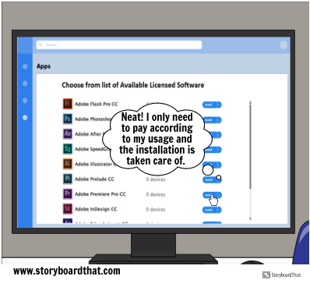
Can also select required licenses if available
Floating licenses enable users to pay according to usage.

Slide 19
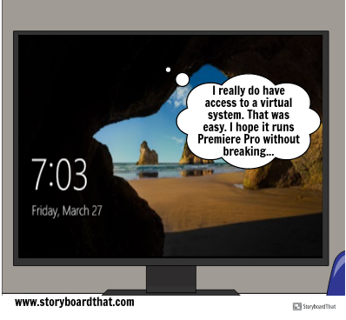
Access to virtual system without concerning oneself with system specification.
No perceivable difference from a local system.

Slide 20
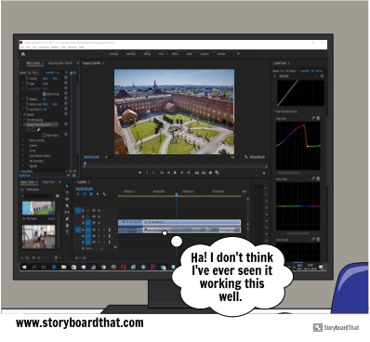
Runs resource intensive applications with ease.
Optimal resources are directly allocated without user interference.

Slide 21
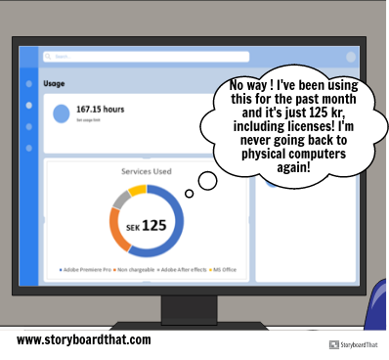
Pay according to time and amount of resources used.
Cheaper than owning a computer for the average user.

Slide 22
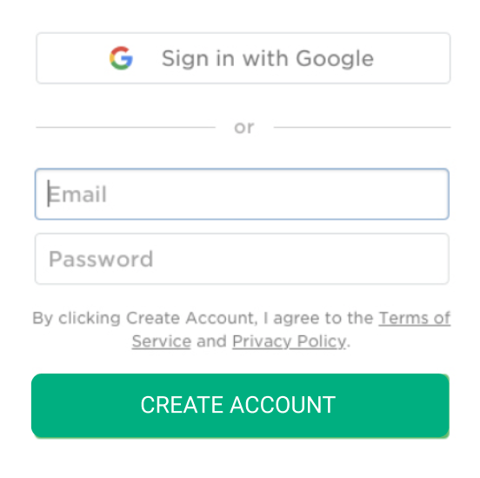

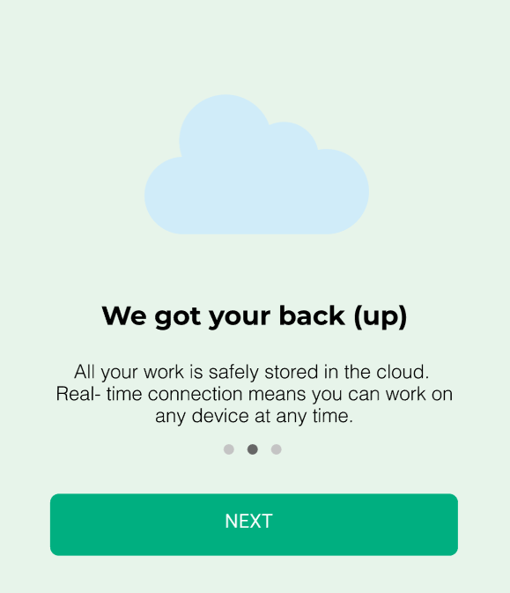
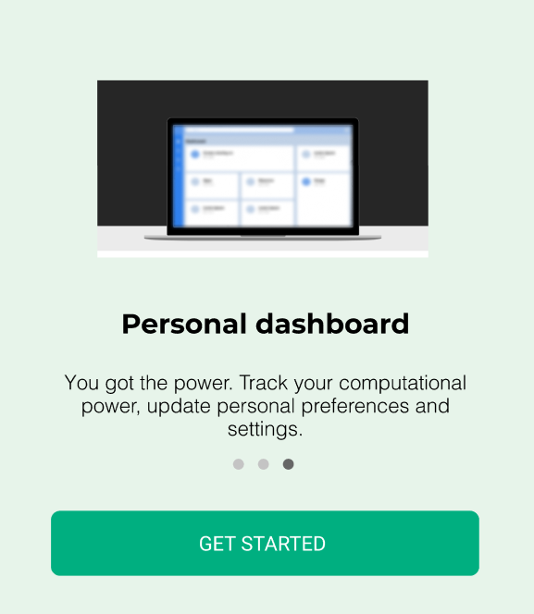
Nickel Tour

Slide 23
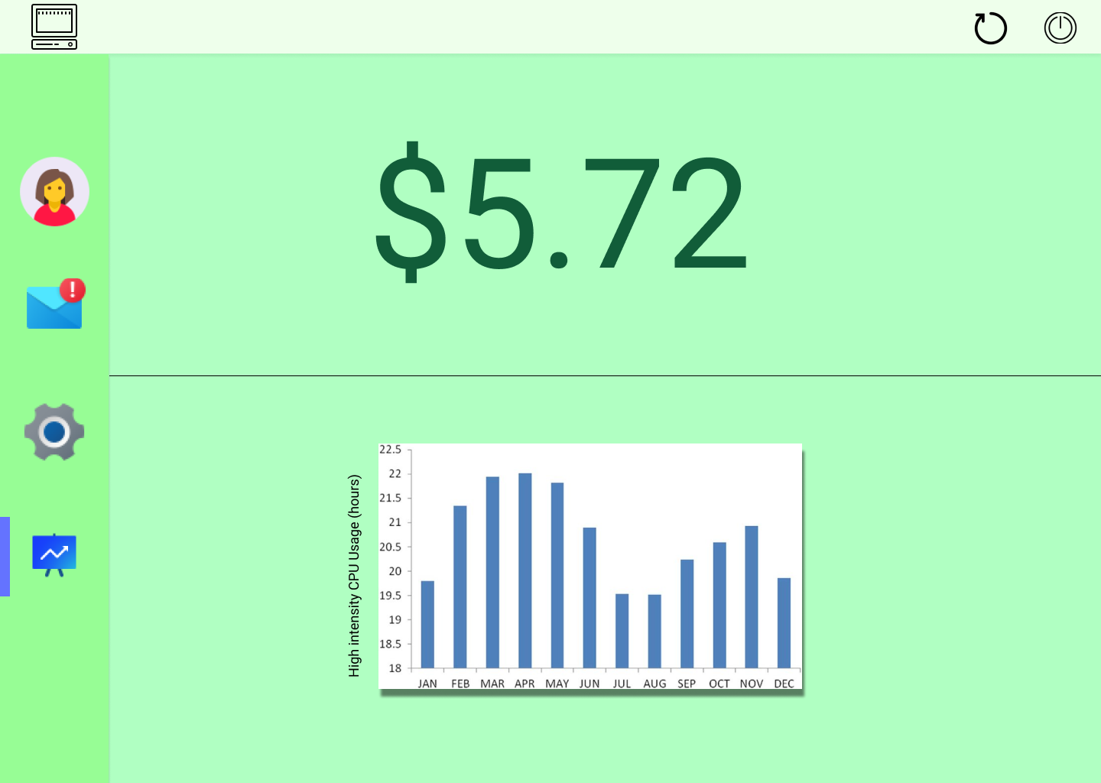
Dashboard

Slide 24

preliminary saving
Cost estimates
Profit margins

Slide 25
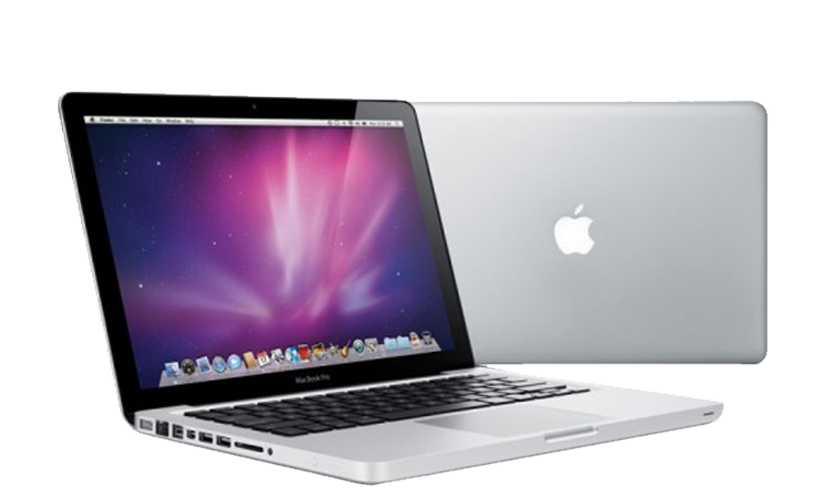
$2,799.00
$46/month (5 years)

Slide 26
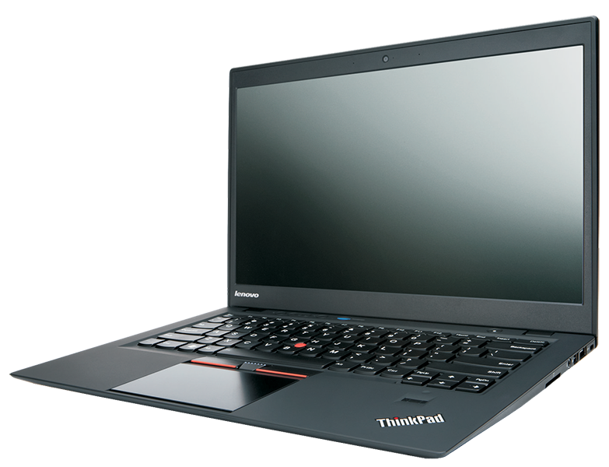
$2,799.00
$46/month (5 years)
$2,234.00
$37/month (5 years)

Slide 27

$2,799.00
$46/month (5 years)
$2,234.00
$37/month (5 years)
$12/month

Slide 28

$20/month

Slide 29
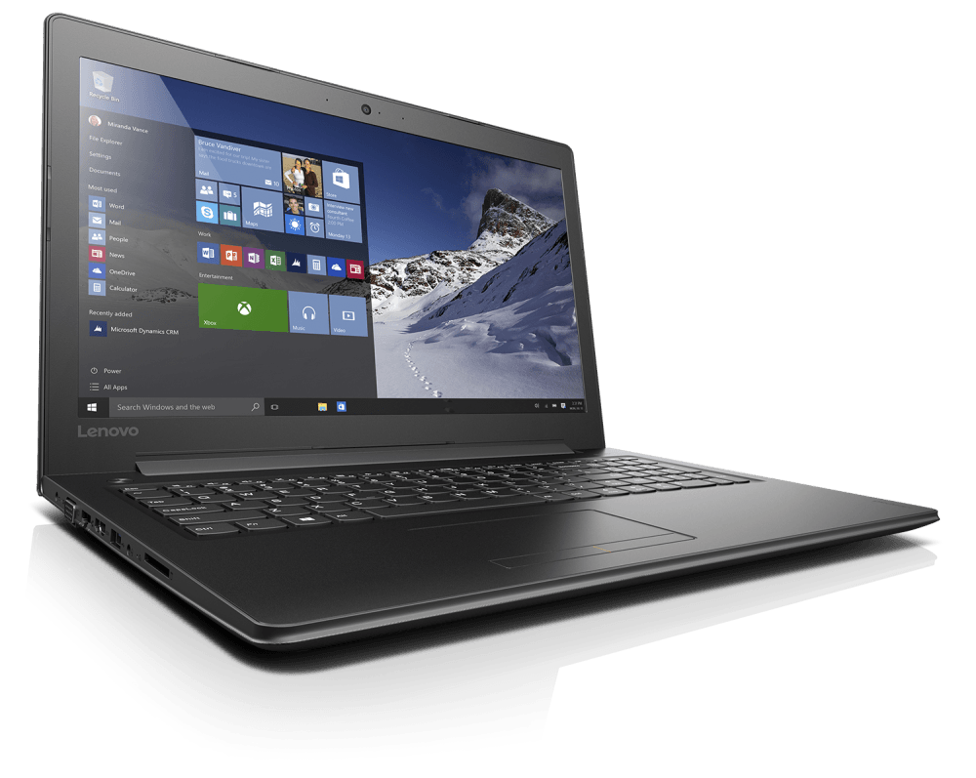
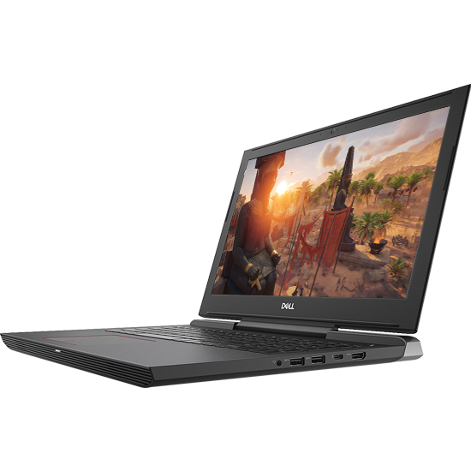
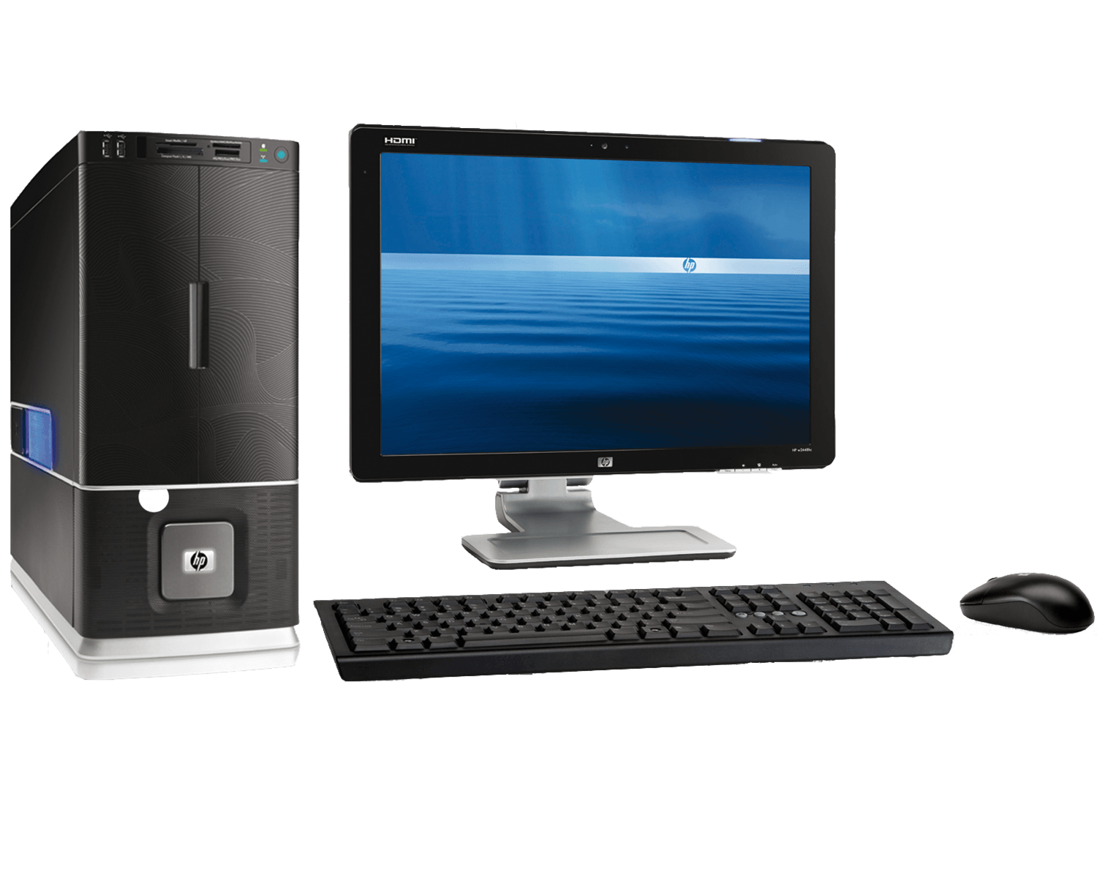
$40/month *24/7
+
~$400
$6/month (5 years)
*free

Slide 30

$2/100GB/month

Slide 31

competitors
"You've got to keep reinventing. You'll have new competitors. You'll have new customers all around you." -- Ginni Rometty, IBM CEO

Slide 32




Google Stadia
Google Drive
Digital Ocean
Amazon Web Services

Slide 33

Timeline
"The two most powerful warriors are patience and time. " – Leo Tolstoy

Slide 34
September 2020
March 2021
July 2020
January 2021
Prototyping tested and revised
Dynamic power allocation to users implemented.
2020 |  |  |  | 2021
Finish first prototype running on a local machine.
First set of servers up and running

Slide 35
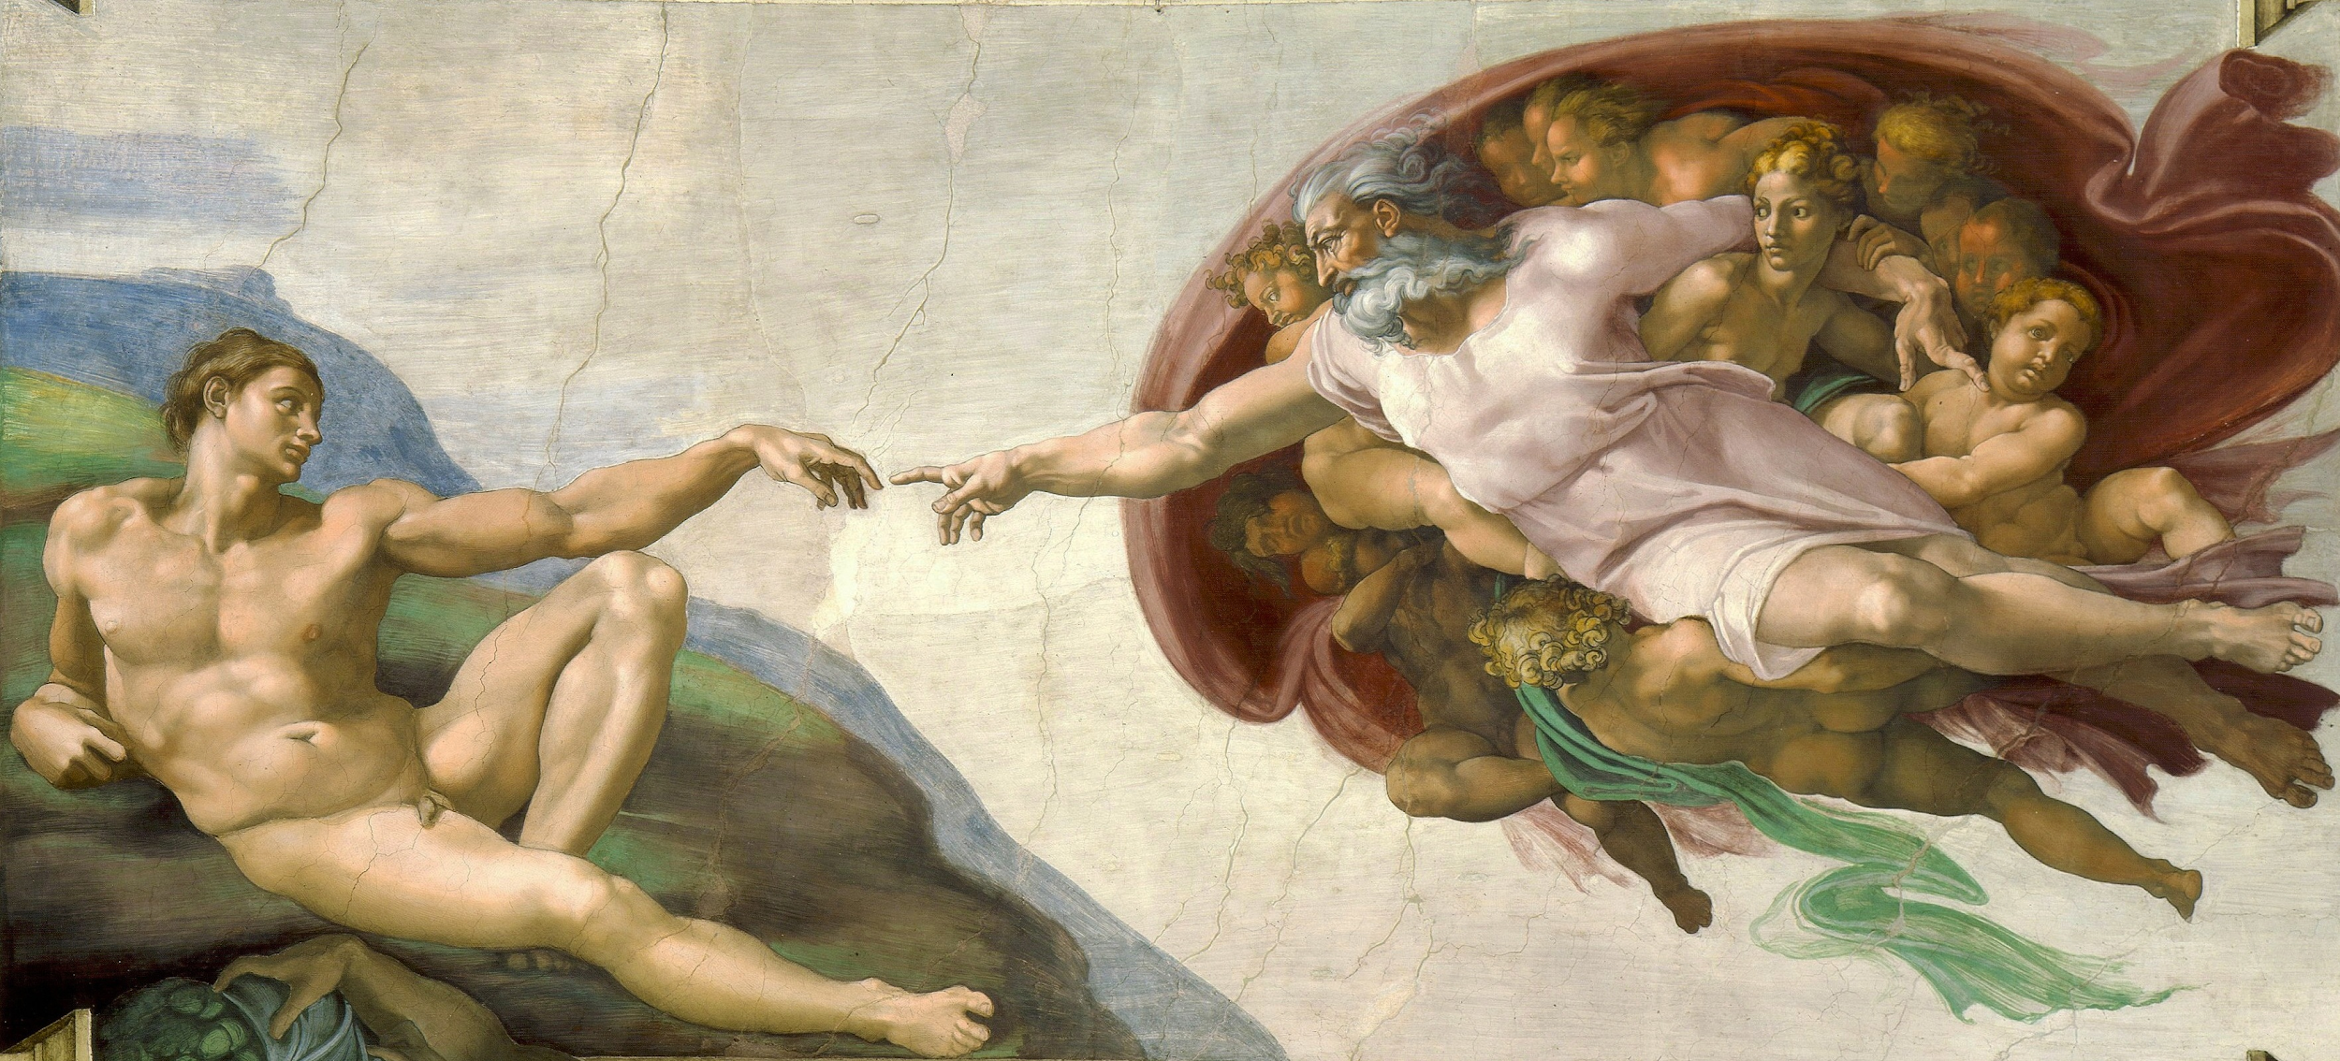
we are adium
cloud
a sustainable quick fix
to keep your computer
powerful, safe & sustainable
- no matter your hardware
user
server

Slide 36
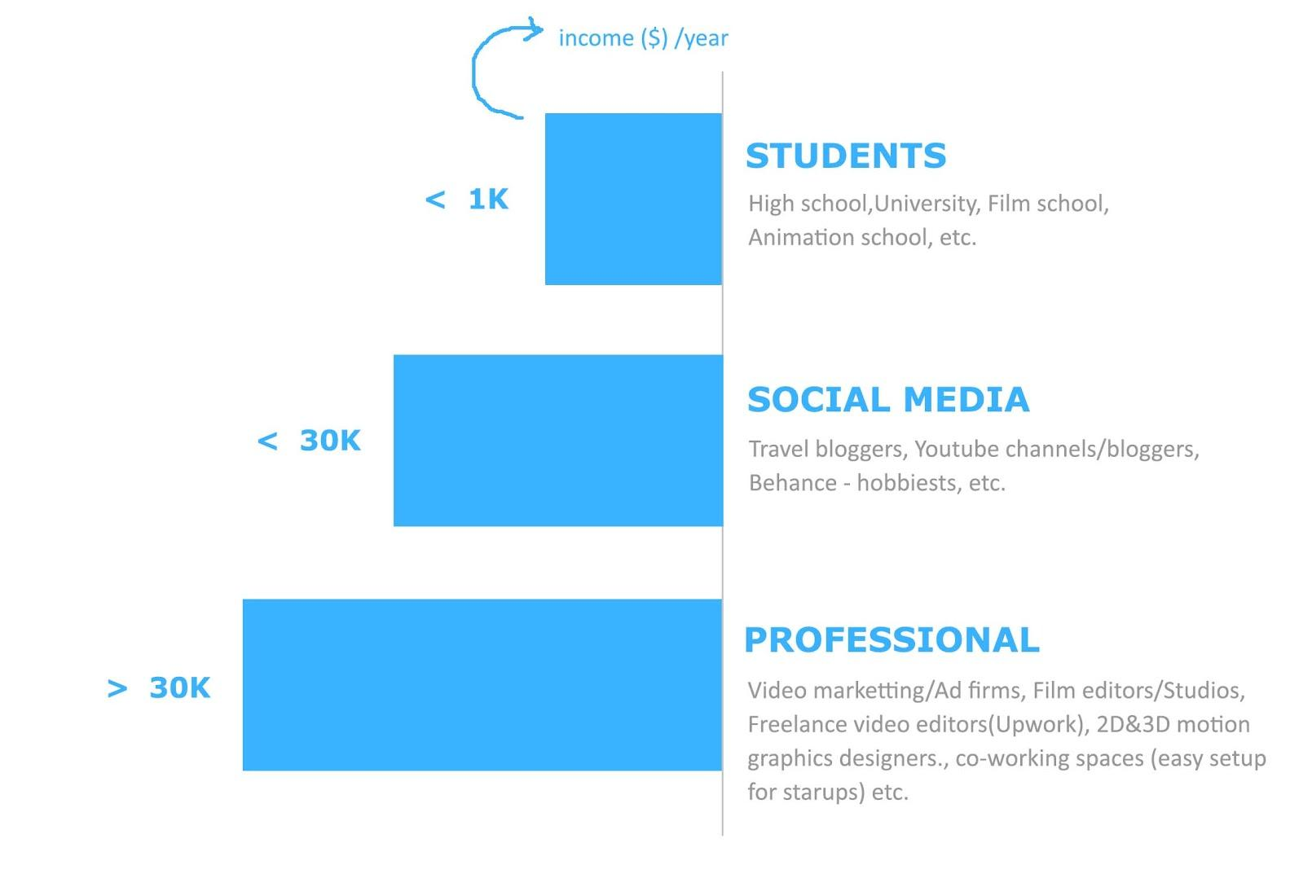
Market segments

